Slide 1
Lean In Circle Session – 3
September 8th

Slide 2
Today‘s Agenda
01
Recursion
Hacker Rank Problems - Part 1
02
Collections - Part 1 – Linked List and Array List
-Namitha
03
Tuples
04
Regular Expression
05
Hacker Rank Problems - Part 2

Slide 3
Hacker Rank Problems – Part 1
https://www.hackerrank.com/challenges/java-1d-array/problem
Based on 1 Dimensional Array and Recursive function

Slide 4
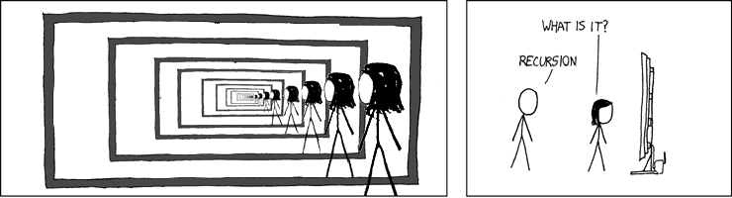
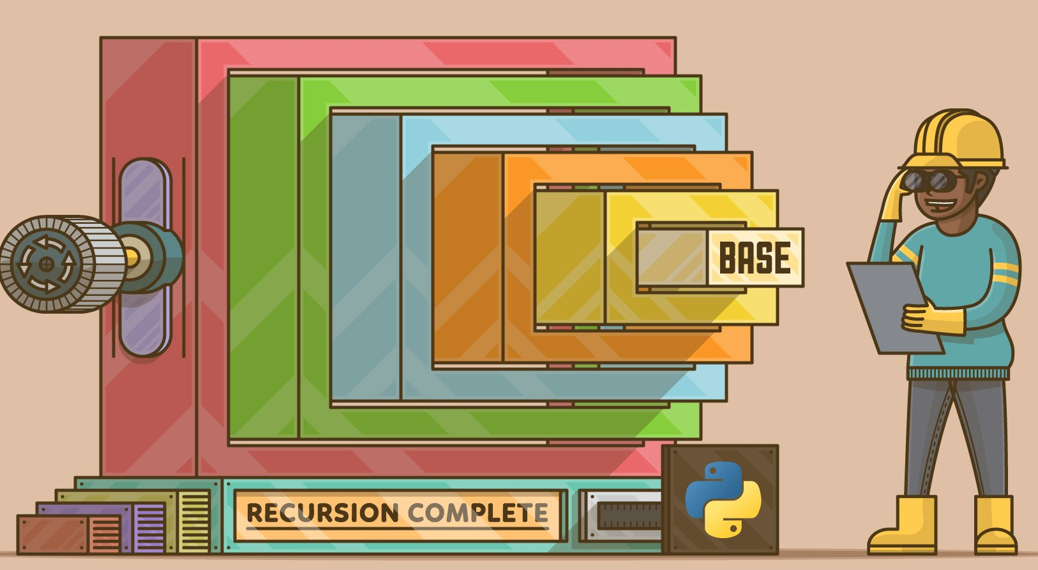
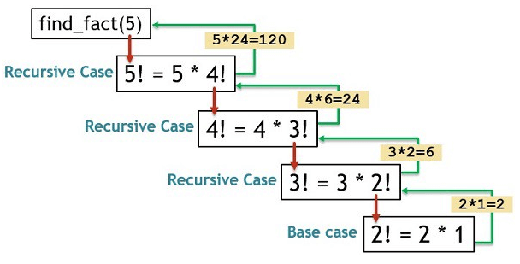
RECURSION

Slide 5
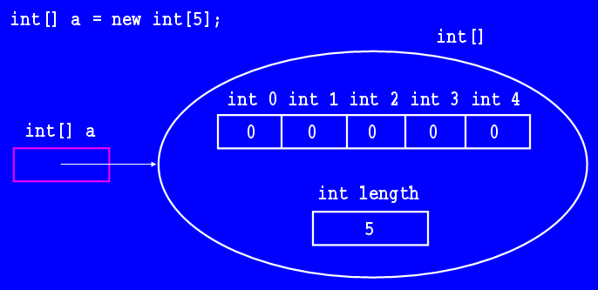
Problem Statement :
Let's play a game on an array! You're standing at index 0th index of an -element , Your end goal is to walk/jump off the end of the array to win the game.
Rules to be followed :
Move Forward (walk / jump) :
If cell i+1 contains a zero, you can walk to cell i+1.
If cell i+leap contains a zero, you can jump to cell i+leap .
If you're standing in cell n-1 or the value of i+leap > n , you can walk or jump off the end of the array and win the game.
Move Backward (walk ):
If cell i-1 exists and contains a 0, you can walk back to cell i-1.
0 -> Gooooood… 1 -> Baddddddddd

Slide 6
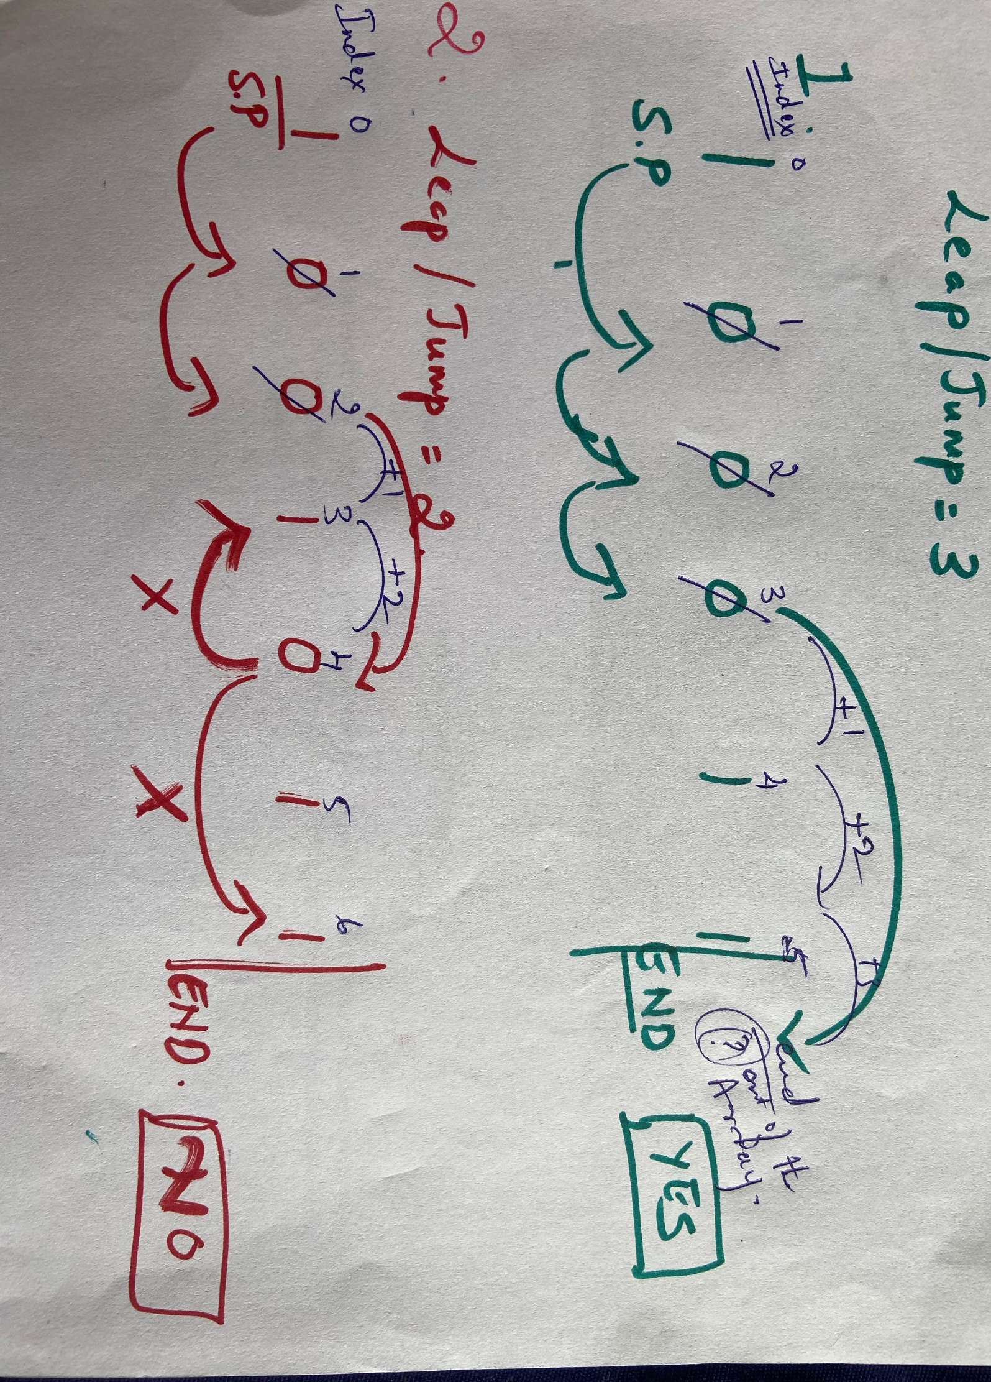
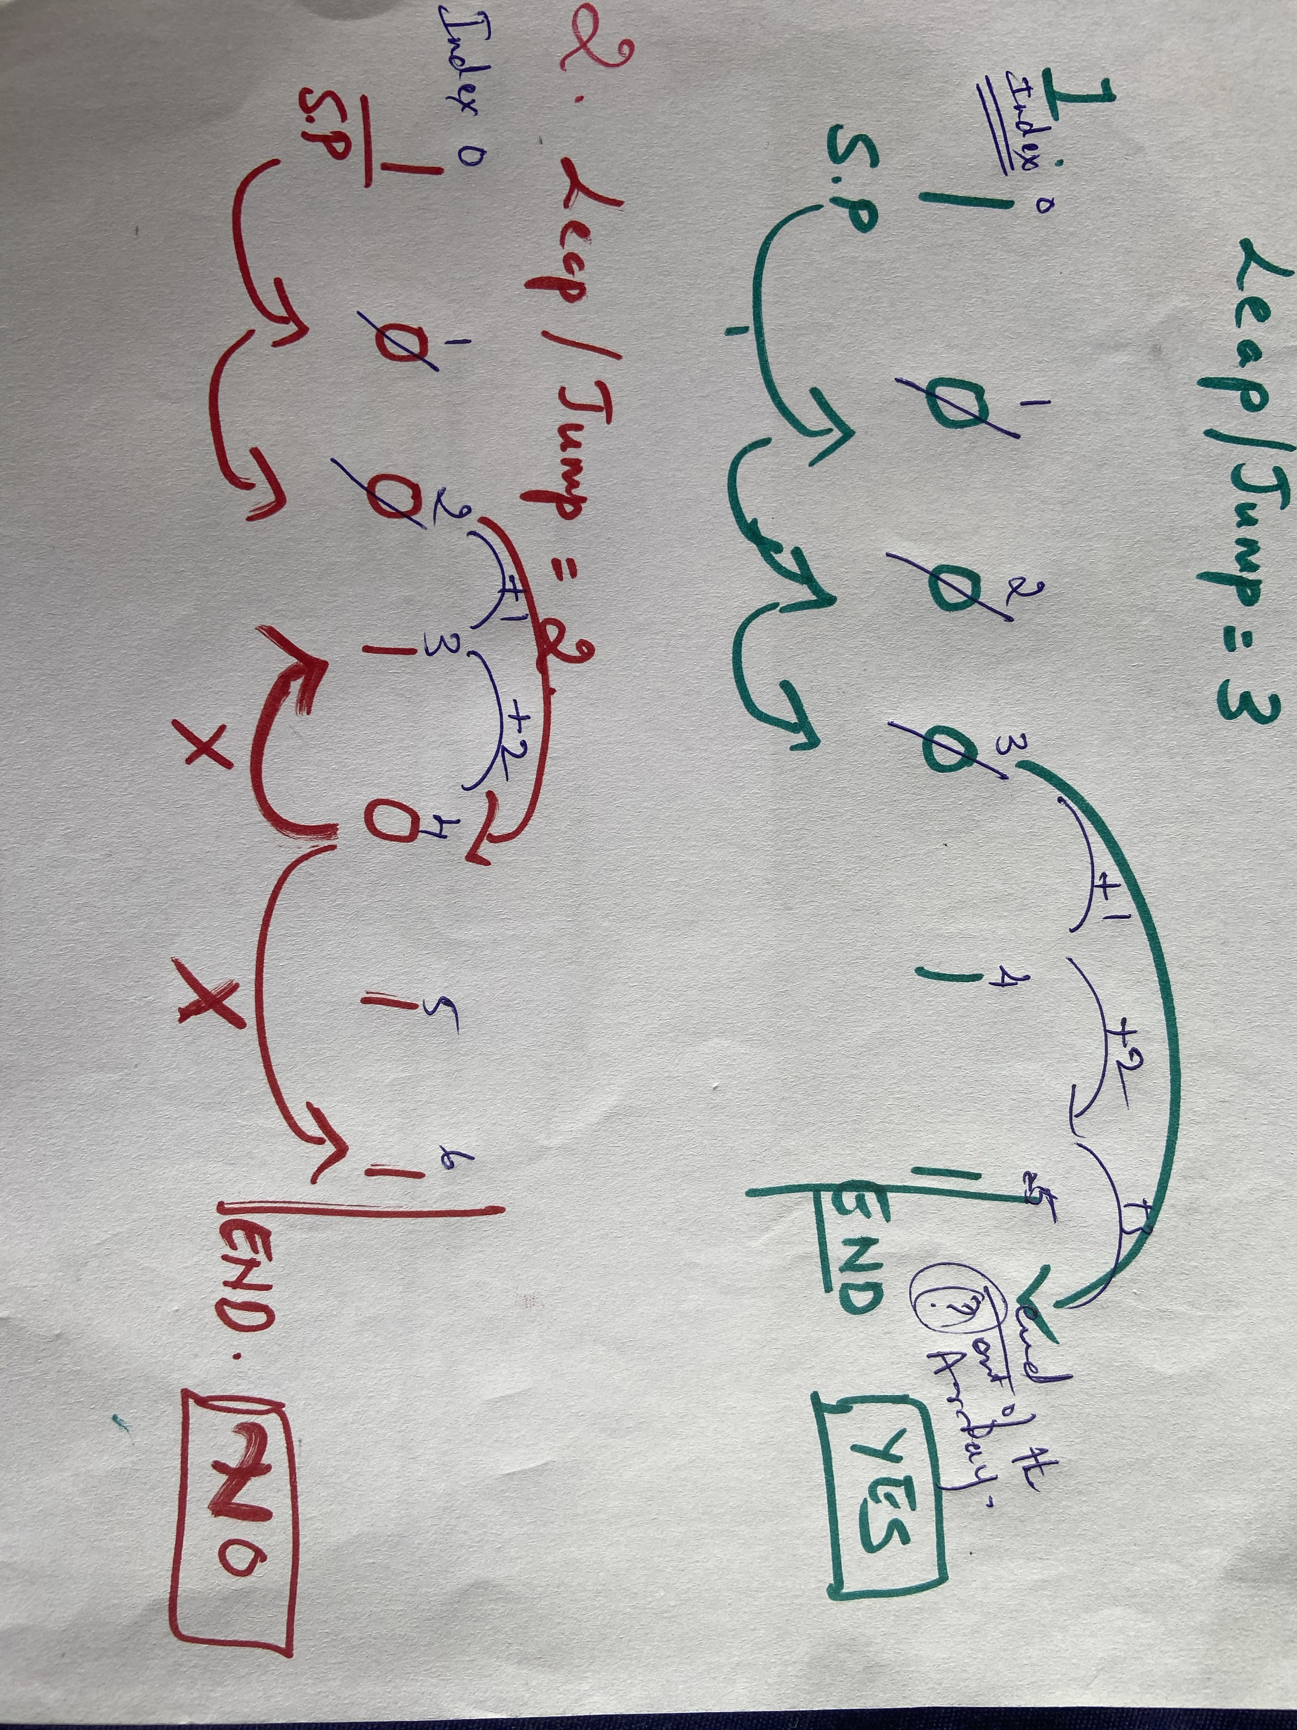
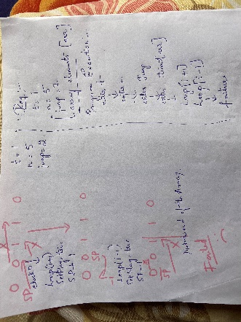
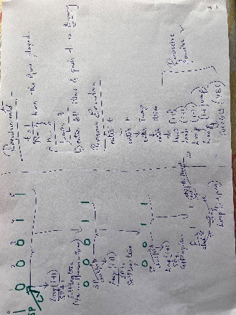
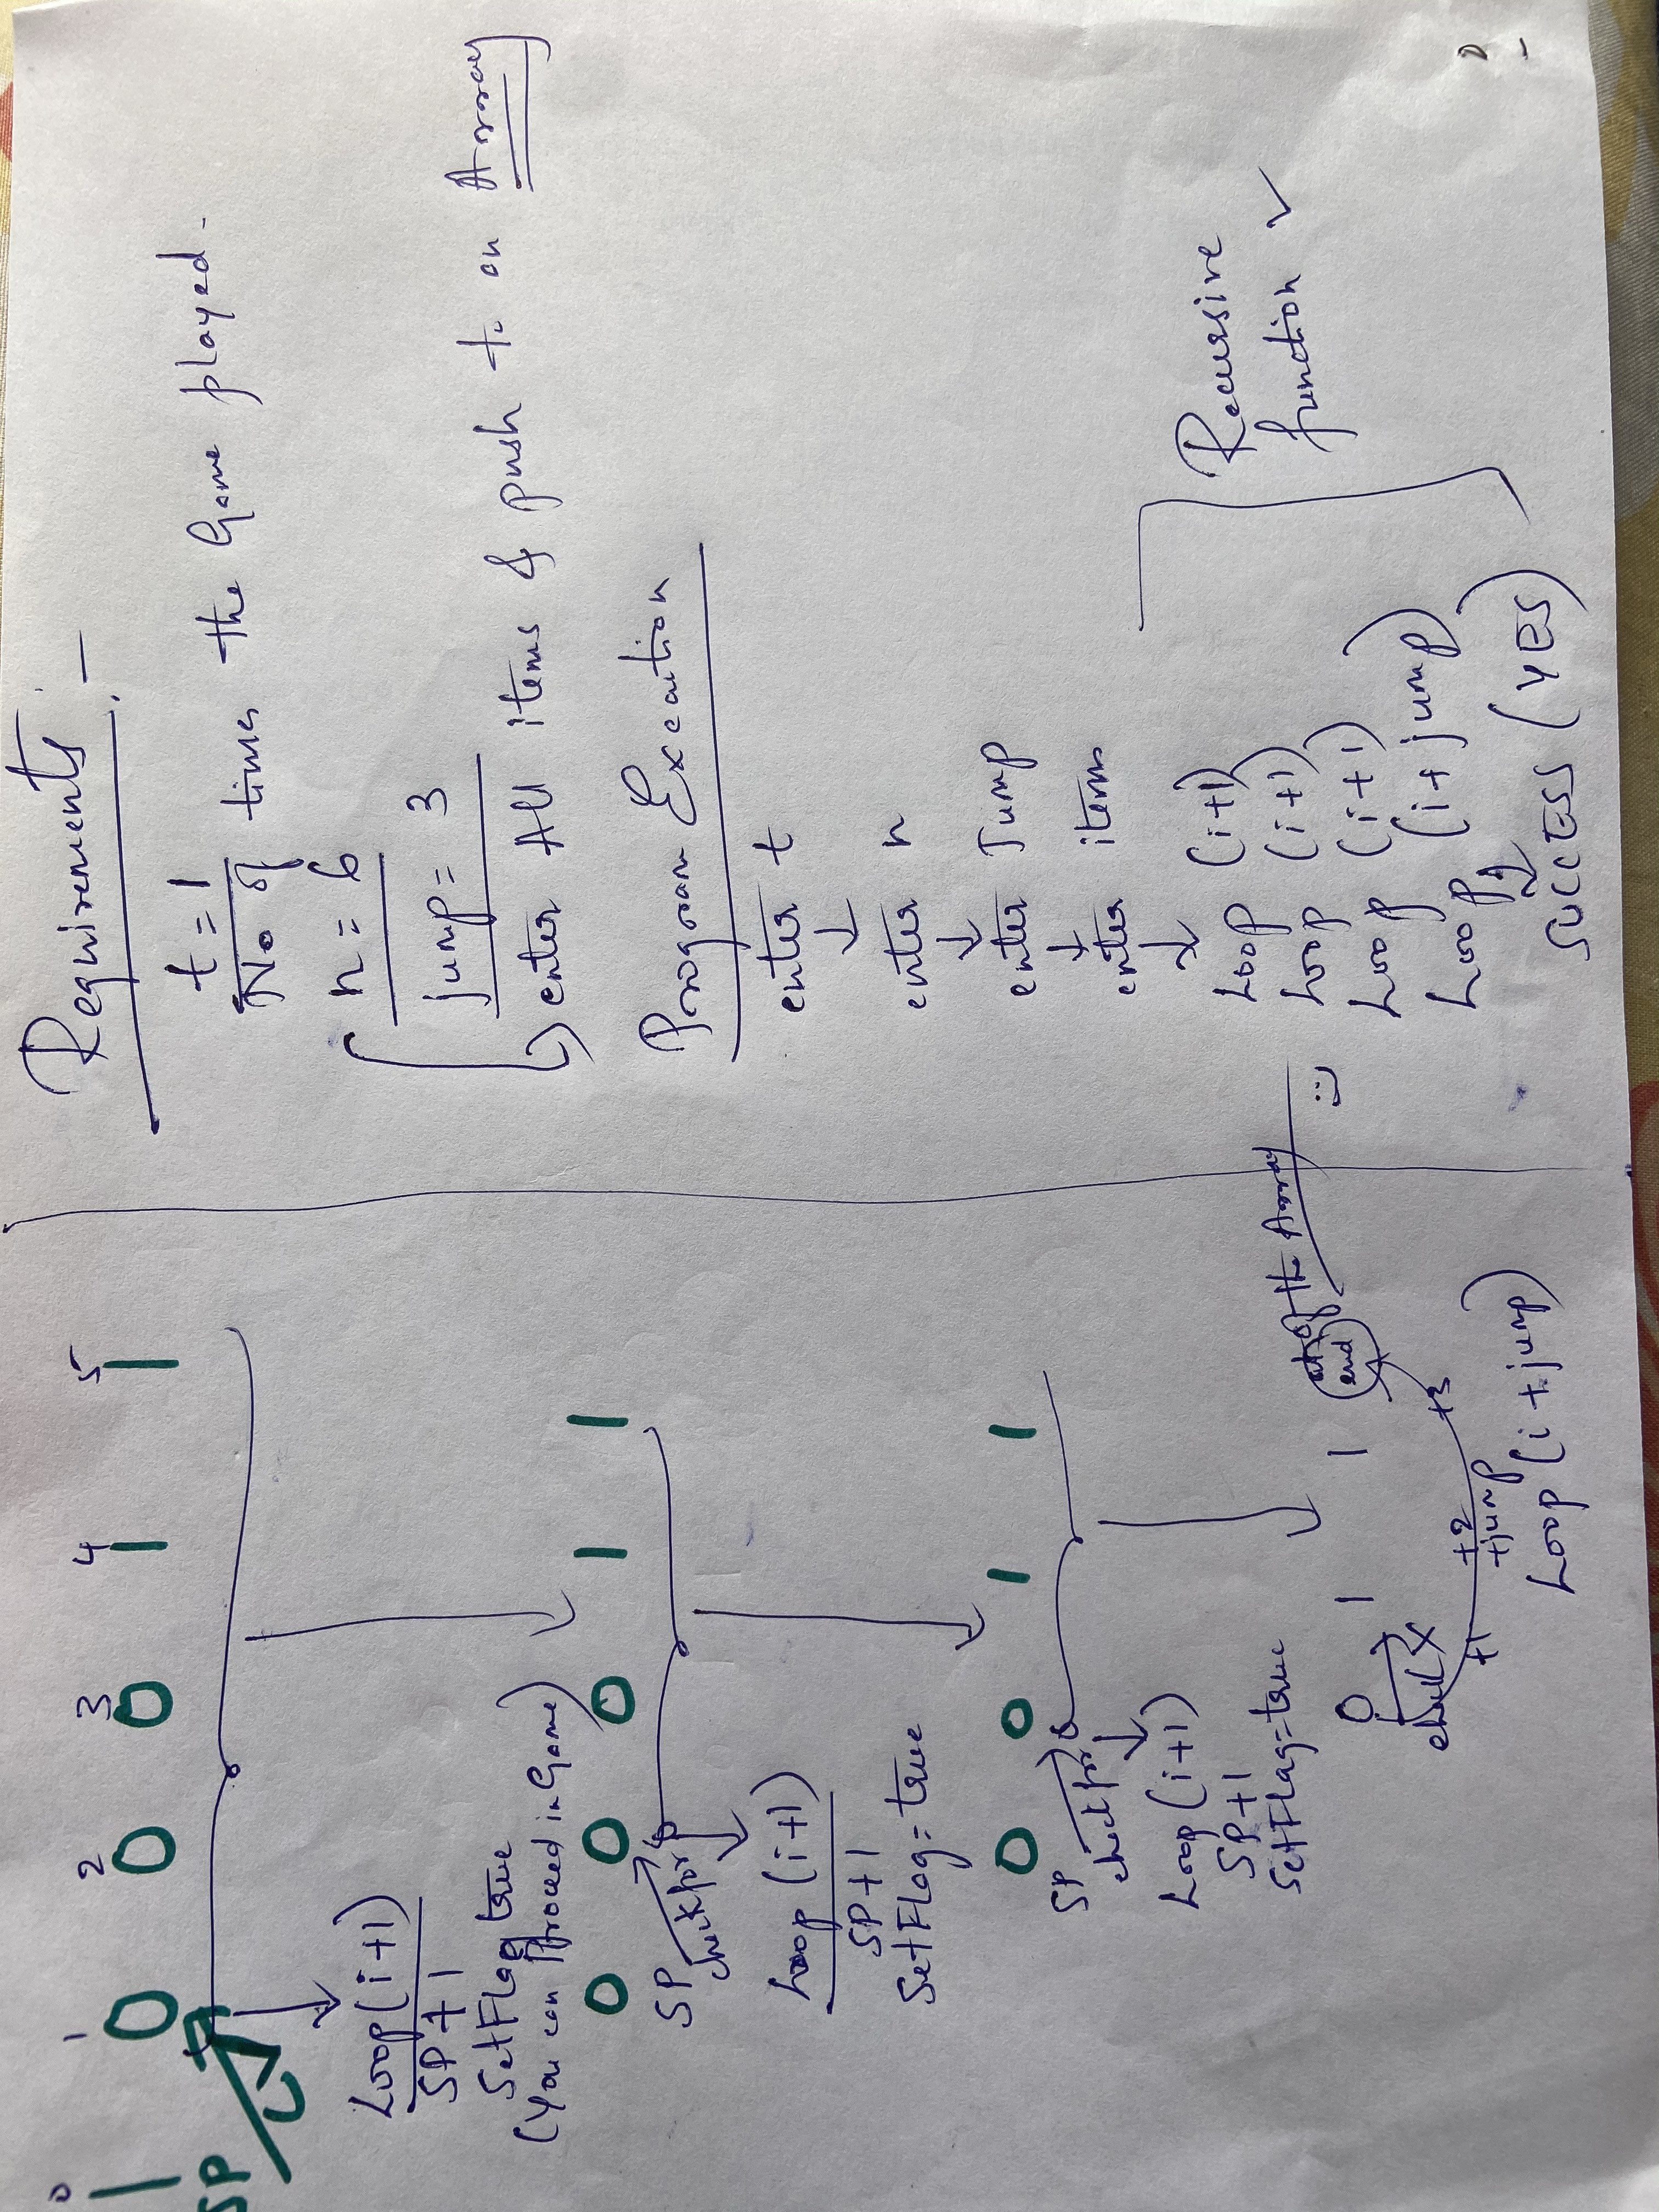
Outlook for iOS

Slide 7
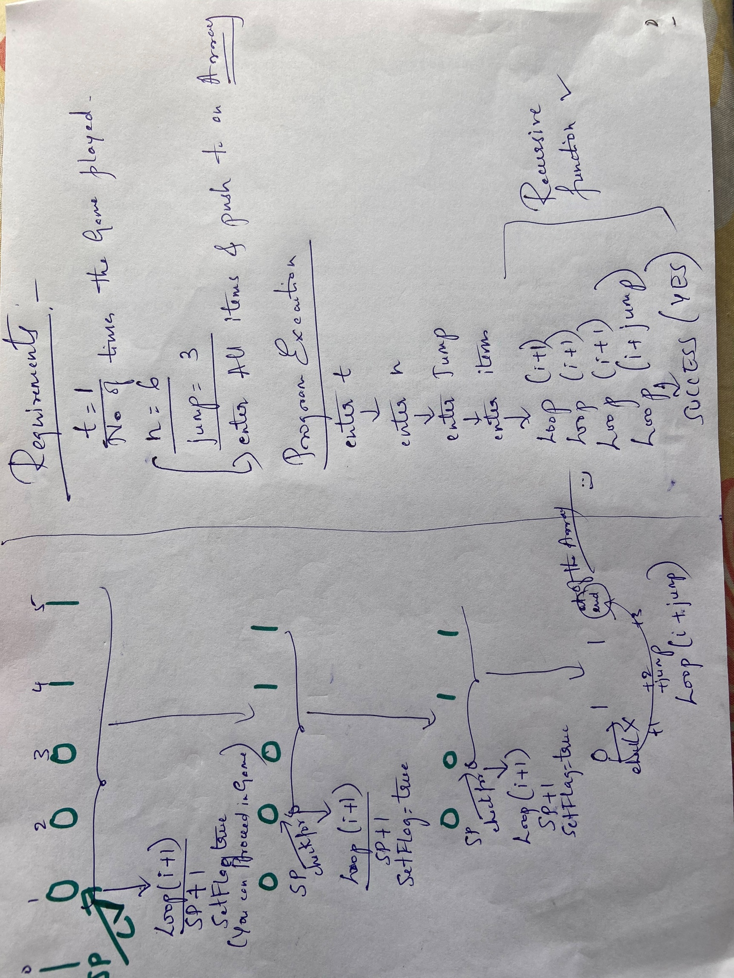
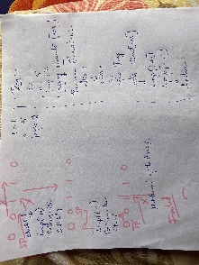
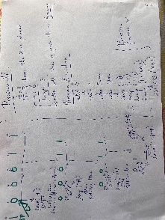

Slide 8



Slide 9
Recursion vs Looping
(next Session – 5 mins)

Slide 10
Collections

Slide 11


Tuples
I'm immutable baby !!
Heterogeneous

Slide 12
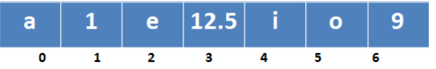
Why Tuples ?
A tuple is an object that can contain heterogeneous data. Lists are designed to store elements of a single type.
While array and list are mutable which means you can change their data value and modify their structures, a tuple is immutable.
If you have a dataset which will be assigned only once in a lifetime and its value should not change again, you need a tuple.
Out of all data structures, a tuple is considered to be the fastest, and they consume the least amount of memory.

Slide 13
Similarities & Differences ?
(Tuple vs List, Array) A tuple is an object that can contain heterogeneous data. Lists are designed to store elements of a single type
(Array, List vs Tuple ) While array and list are mutable which means you can change their data value and modify their structures, a tuple is immutable.
(Array & Tuple ) Like an array, a tuple is also fixed in size. That is why tuples aim to replace array completely as they are more efficient in all parameters.

Slide 14
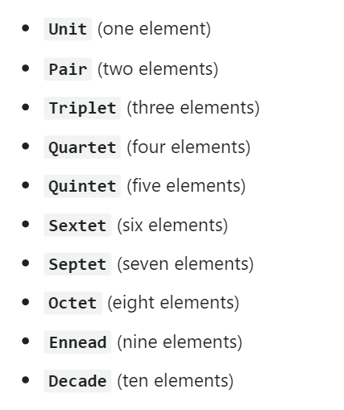
import org.javatuples.*;
Some of the Javatuple classes available

Slide 15
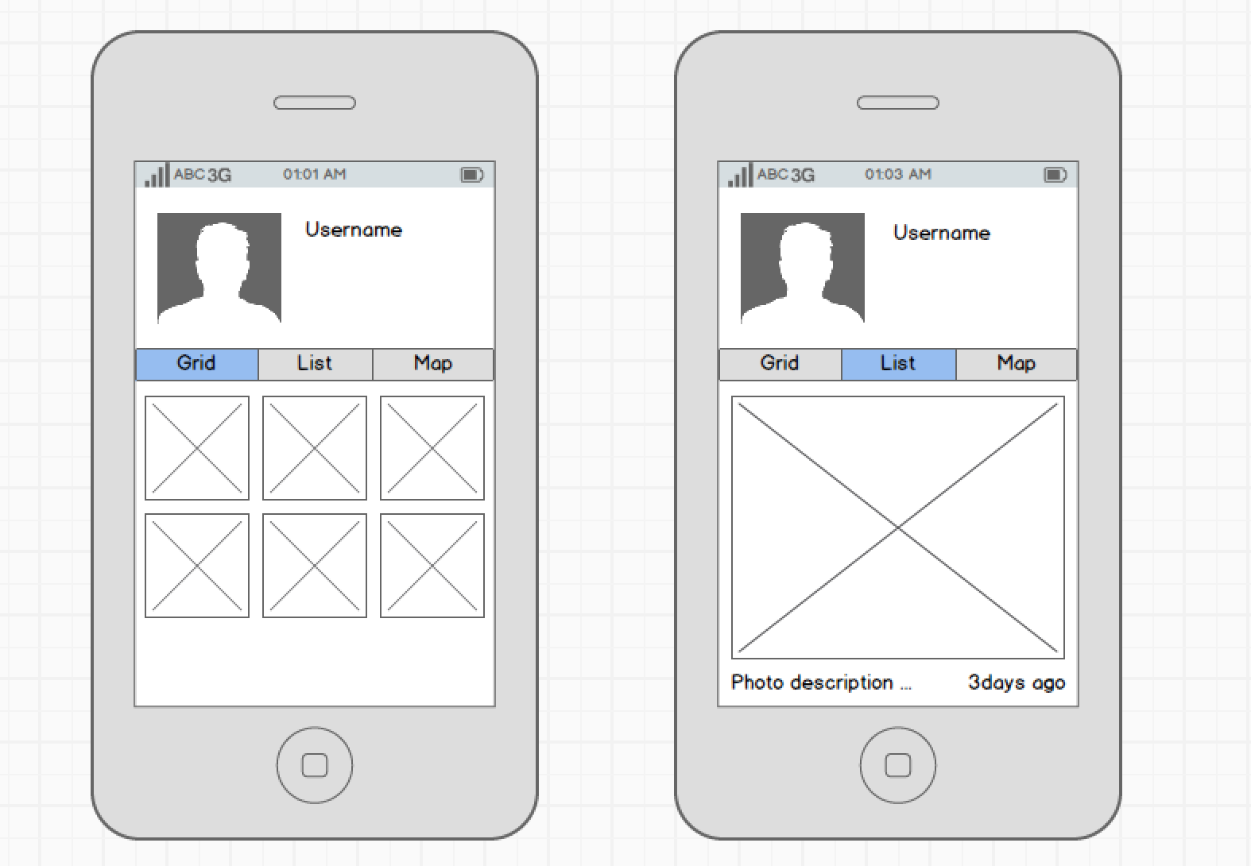





Class prototype

Slide 16
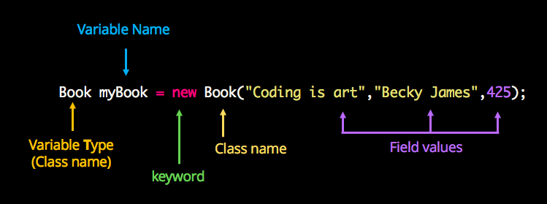
Instagram profile1 = new Instagram(“Ramya”, ProfilePic, bio);
Declaration: The code set in bold are all variable declarations that associate a variable name with an object type.
Instantiation: The new keyword is a Java operator that creates the object.
Initialization: The new operator is followed by a call to a constructor, which initializes the new object. https://howtodoinjava.com/java/java-misc/java-tuples/

Slide 17
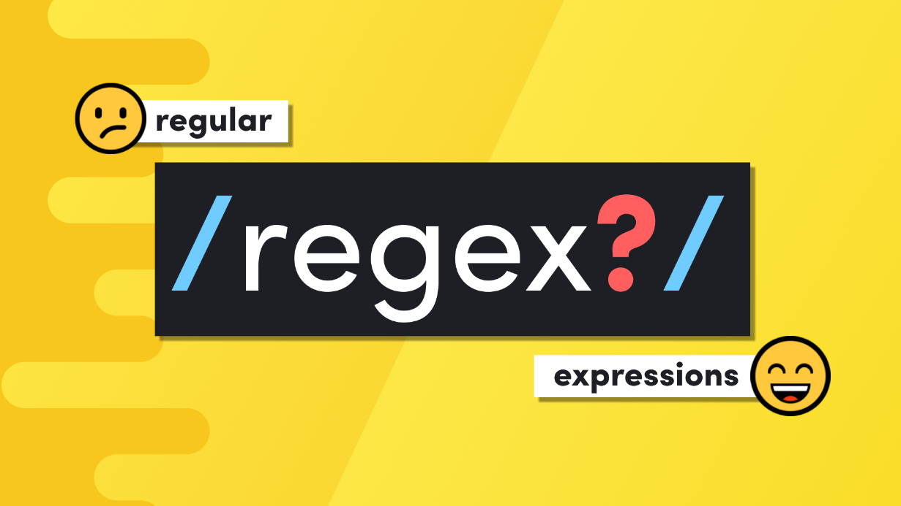
Searching / Matching
Extracting
Validation
Examples :
Regular expressions are used in search engines and ??

Slide 18
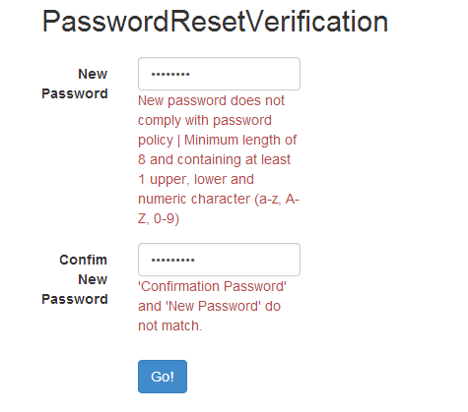
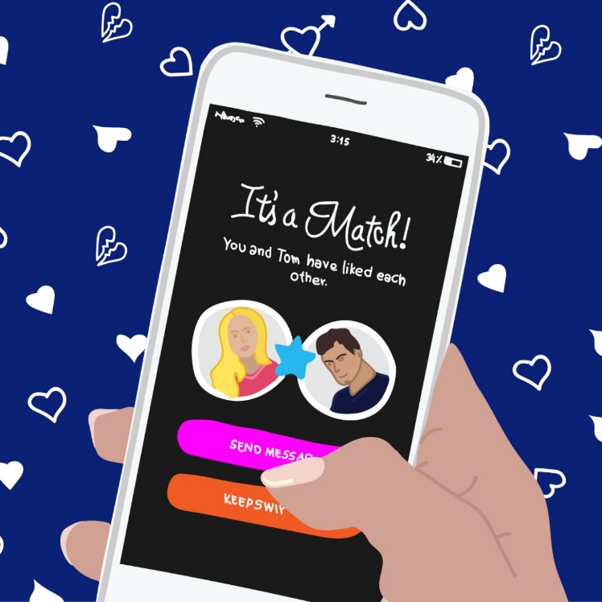

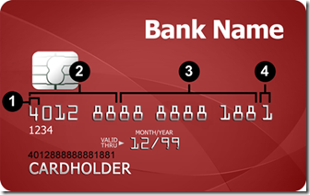
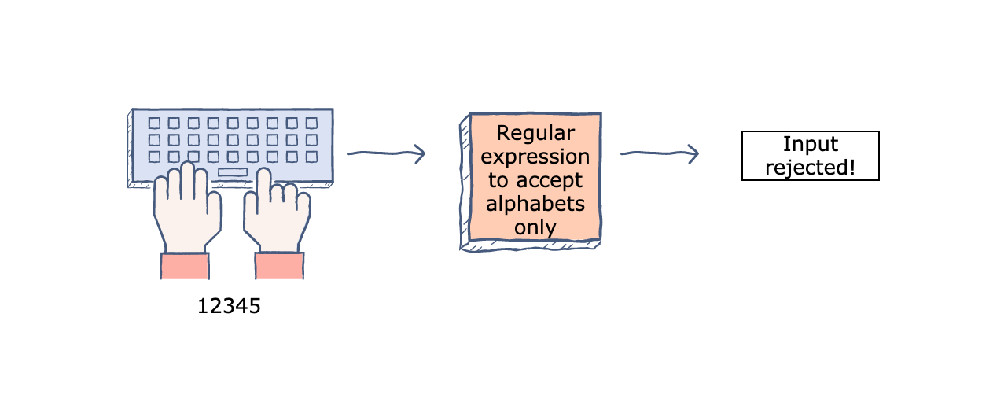
Regular expression

Slide 19
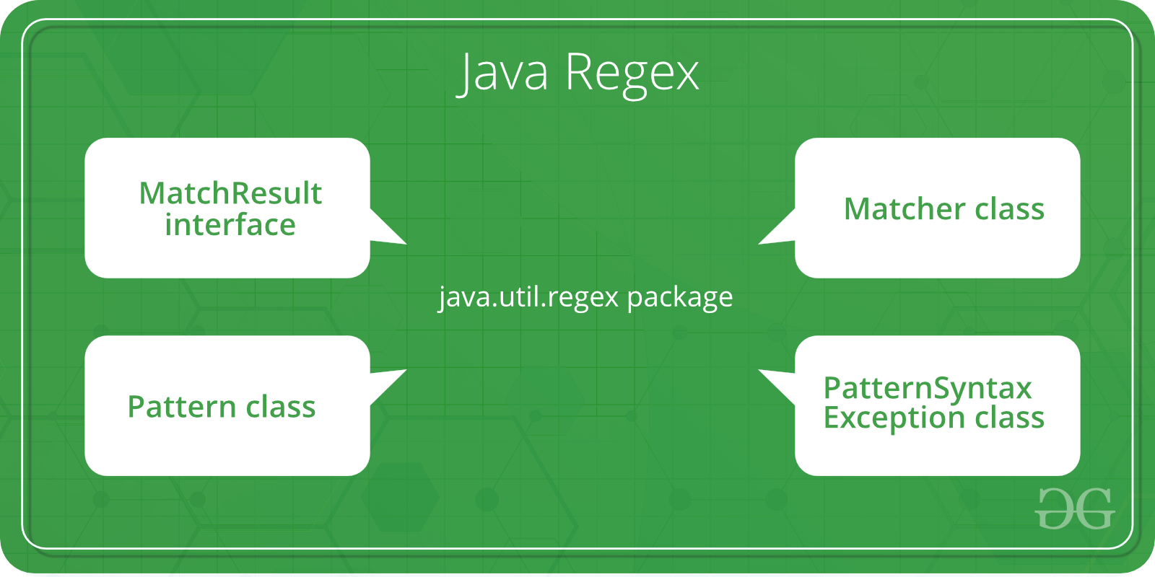
When you know the Regex Pattern Requirement (pre-defined Expression).
When you don’t know the Regex pattern (ex: Pattern read by user Input)

Slide 20
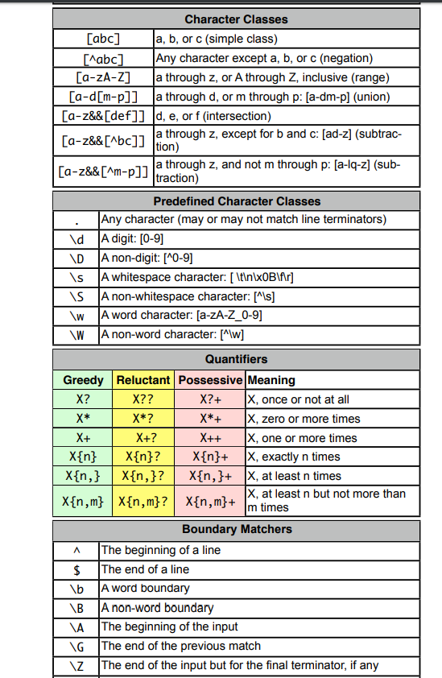
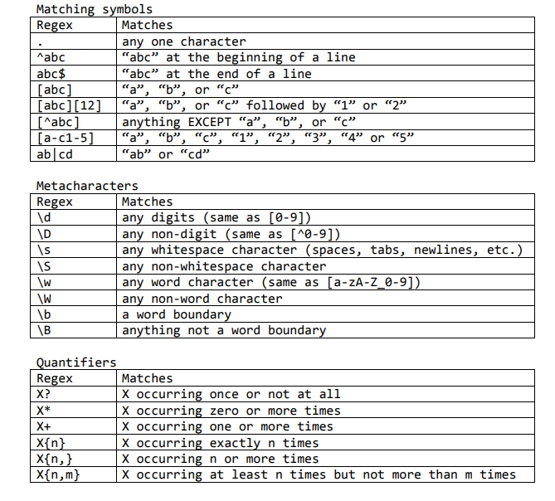
Regular Expression Cheat Sheet

Slide 21
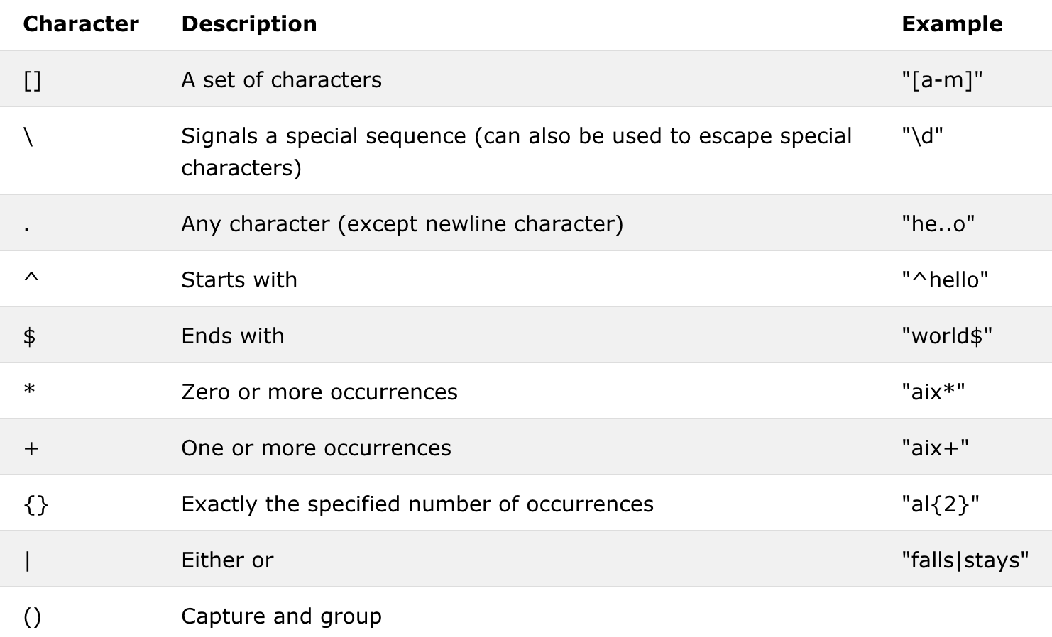
? – At least one

Slide 22
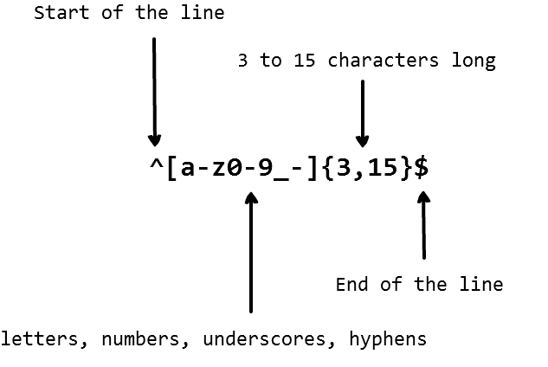
Basic RE code

Slide 23
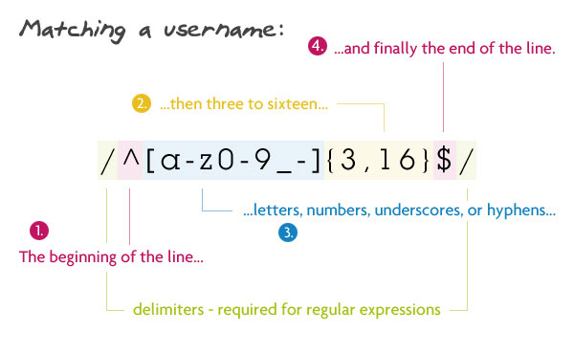
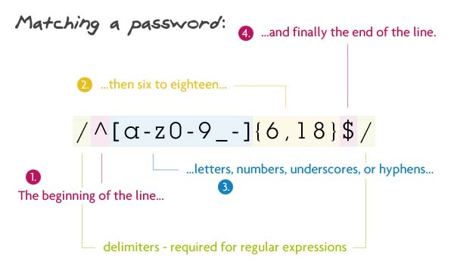
Matching Username and password
Valid-Username & Invalid-Username : Sarah-256 Mynameis_Oliver123
Valid-Password : Cloud@123#

Slide 24
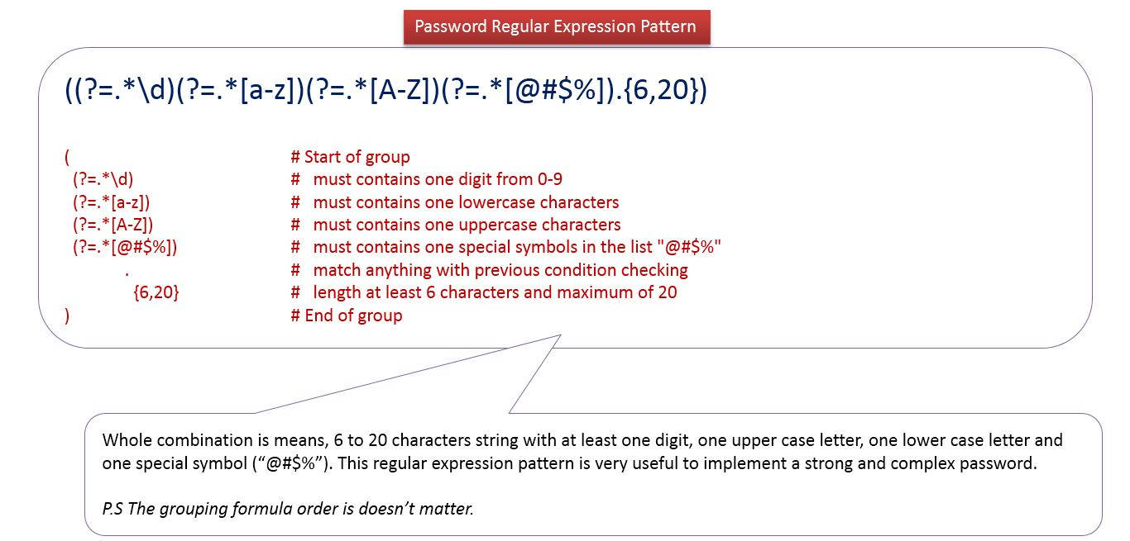
Improvised Password Matching

Slide 25
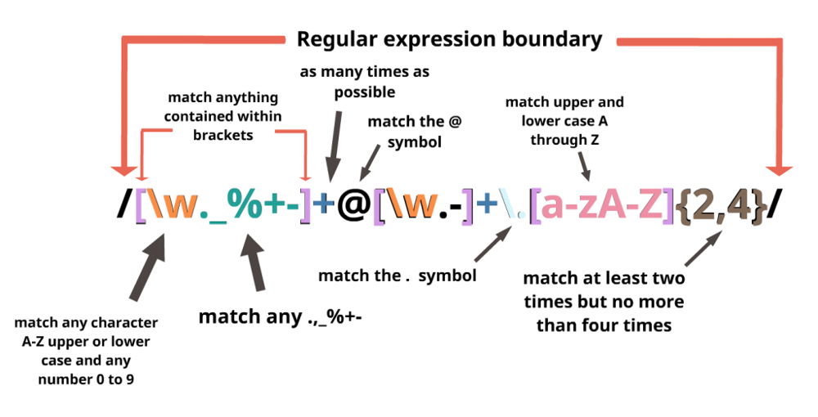
Matching an E-Mail – john.doe43@domainsample.com

Slide 26
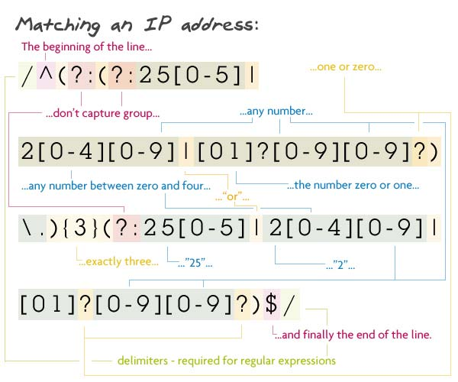
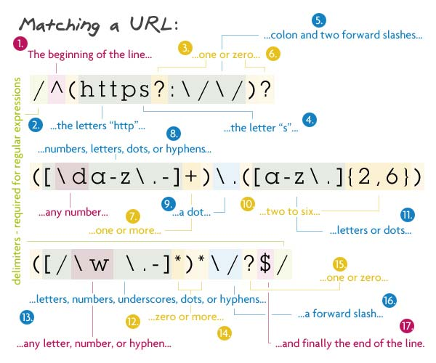
Matching an IP address & URL (Assignment)
IP : 192.168.190.34
URL : https://www.hackerrank.com/

Slide 27
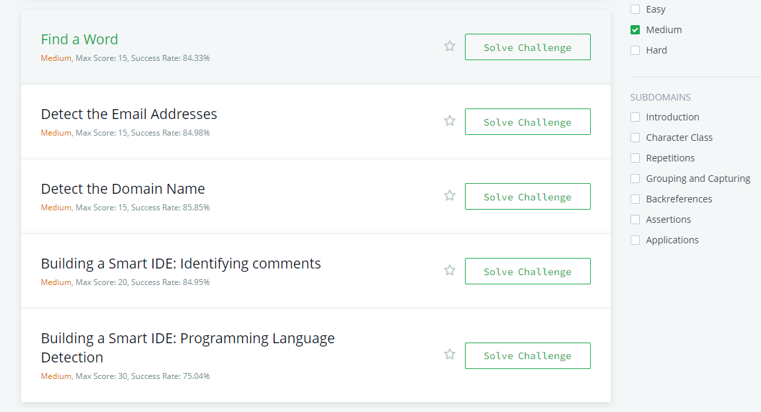

Slide 28
What's Next ??
Recursion vs Looping , Dictionary & JSON (Ramya)
Get started with classes in Java
Why Objects? - its Usage .
Inheritance
Interface
Packages (creation and usage)
By Next Session:
Try it out :
https://www.hackerrank.com/challenges/valid-username-checker/problem
Come up with one R.E Application you can think of.

